Slide 1

Chapter 3 Transport Layer
A note on the use of these PowerPoint slides:
We’re making these slides freely available to all (faculty, students, readers). They’re in PowerPoint form so you see the animations; and can add, modify, and delete slides (including this one) and slide content to suit your needs. They obviously represent a lot of work on our part. In return for use, we only ask the following:
If you use these slides (e.g., in a class) that you mention their source (after all, we’d like people to use our book!)
If you post any slides on a www site, that you note that they are adapted from (or perhaps identical to) our slides, and note our copyright of this material.
For a revision history, see the slide note for this page.
Thanks and enjoy! JFK/KWR
All material copyright 1996-2020
J.F Kurose and K.W. Ross, All Rights Reserved
Computer Networking: A Top-Down Approach 8th edition Jim Kurose, Keith Ross Pearson, 2020
Notes:
These notes are written by the instructor for students to read after class. This title slide marks the beginning of the Transport Layer chapter.
The transport layer is where host-to-host communication becomes process-to-process communication. From this point on, students should focus on sockets, ports, reliability, and how applications receive service from transport protocols.
This chapter matters because it connects application behavior with protocol design. Later topics such as TCP, reliable data transfer, and congestion control all depend on this foundation.

Slide 2
Transport layer: overview
Our goal:
understand principles behind transport layer services:
multiplexing, demultiplexing
reliable data transfer
flow control
congestion control
learn about Internet transport layer protocols:
UDP: connectionless transport
TCP: connection-oriented reliable transport
TCP congestion control
Notes:
This slide gives the big picture of the chapter. The main services of the transport layer are multiplexing, demultiplexing, reliable transfer, flow control, and congestion control.
Students should not treat this list as isolated definitions. Each service exists because applications need different kinds of communication support.
The practical goal of the week is to understand why the Internet uses both UDP and TCP and what each one adds on top of the network layer.

Slide 3

Transport layer: roadmap
Transport-layer services
Multiplexing and demultiplexing
Connectionless transport: UDP
Principles of reliable data transfer
Connection-oriented transport: TCP
Principles of congestion control
TCP congestion control
Evolution of transport-layer functionality
Notes:
This roadmap slide shows the full structure of Chapter 3. It is useful as a navigation tool.
The chapter starts with transport-layer services and basic multiplexing, then moves to UDP, reliable data transfer principles, TCP, and congestion-related ideas.
Students should keep returning to this map so that each new concept is seen as part of a larger sequence rather than as a disconnected topic.

Slide 4








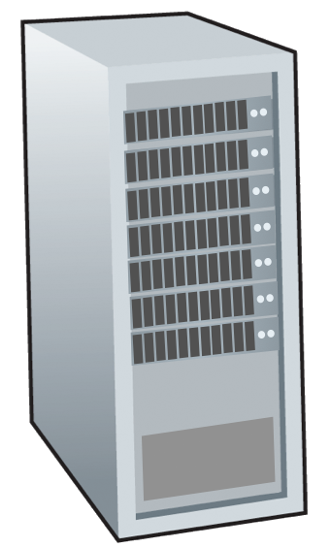







Transport services and protocols
application
transport
network
data link
physical
provide logical communication between application processes running on different hosts
mobile network
national or global ISP
transport protocols actions in end systems:
sender: breaks application messages into segments, passes to network layer
receiver: reassembles segments into messages, passes to application layer
logical end-end transport
local or regional ISP
home network
content
provider
network
application
transport
network
data link
physical
datacenter
network
two transport protocols available to Internet applications
TCP, UDP
enterprise
network
Notes:
This slide introduces the core idea of the transport layer: logical communication between application processes running on different hosts.
The sender breaks application messages into segments and passes them to the network layer. The receiver reassembles the data and delivers it to the correct application.
Students should remember that TCP and UDP operate in the end systems, not in the routers. That is why the slide emphasizes sender-side and receiver-side actions.

Slide 5
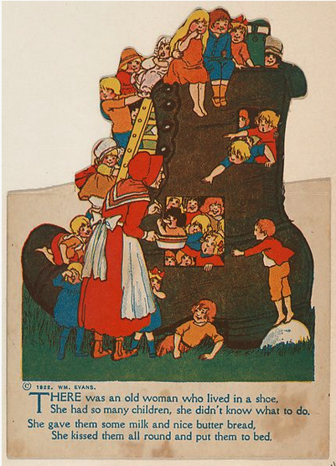
Transport vs. network layer services and protocols
household analogy:
12 kids in Ann’s house sending letters to 12 kids in Bill’s house:
hosts = houses
processes = kids
app messages = letters in envelopes
transport protocol = Ann and Bill who demux to in-house siblings
network-layer protocol = postal service
Notes:
This slide uses the household analogy to compare transport and network responsibilities. The postal service moves letters between houses, while people inside the house deliver them to the correct child.
That is exactly the difference between network-layer delivery between hosts and transport-layer delivery between processes.
Students should use this analogy to remember why ports and demultiplexing exist.

Slide 6
Transport vs. network layer services and protocols
network layer: logical communication between hosts
transport layer: logical communication between processes
relies on, enhances, network layer services
household analogy:
12 kids in Ann’s house sending letters to 12 kids in Bill’s house:
hosts = houses
processes = kids
app messages = letters in envelopes
transport protocol = Ann and Bill who demux to in-house siblings
network-layer protocol = postal service
Notes:
This slide restates the key distinction between the network layer and the transport layer. The network layer offers logical communication between hosts, while the transport layer offers logical communication between processes.
The transport layer relies on the network layer but also enhances its service.
Students should see transport as a refinement layer that makes host-level delivery useful for real applications.

Slide 7
Transport Layer Actions
Sender:
application
application
is passed an application-layer message
app. msg
determines segment header fields values
T_{h}
transport
app. msg
transport
T_{h}
creates segment
network (IP)
network (IP)
passes segment to IP
link
link
physical
physical
Notes:
This slide focuses on sender-side transport actions. The application hands a message down, the transport layer chooses header values, creates a segment, and passes it to IP.
The segment is the transport layer's unit of work. Header fields are not decoration; they control how the receiver will interpret and deliver the data.
Students should understand this sequence clearly before moving into multiplexing and demultiplexing.

Slide 8
Transport Layer Actions
Receiver:
application
receives segment from IP
application
checks header values
transport
transport
app. msg
extracts application-layer message
network (IP)
network (IP)
demultiplexes message up to application via socket
link
link
physical
physical
app. msg
T_{h}
Notes:
This slide shows the receiver-side transport actions. The transport layer receives a segment from IP, checks relevant header values, extracts the application data, and demultiplexes it to the correct socket.
This is where process-level delivery becomes visible.
Students should think of the transport layer as the side that knows which application should receive the data after the network layer has brought the segment to the host.

Slide 9
Two principal Internet transport protocols
application
transport
network
data link
physical
TCP: Transmission Control Protocol
reliable, in-order delivery
congestion control
flow control
connection setup
UDP: User Datagram Protocol
unreliable, unordered delivery
no-frills extension of “best-effort” IP
services not available:
delay guarantees
bandwidth guarantees
mobile network
national or global ISP
logical end-end transport
local or regional ISP
home network
content
provider
network
application
transport
network
data link
physical
datacenter
network
enterprise
network
Notes:
This slide compares the two principal transport protocols in the Internet: TCP and UDP.
TCP offers reliability, in-order delivery, flow control, congestion control, and connection setup. UDP offers a lightweight, connectionless service with very little added structure.
Students should not jump to the conclusion that TCP is always better. The better protocol depends on the needs of the application.

Slide 10
Chapter 3: roadmap
Transport-layer services
Multiplexing and demultiplexing
Connectionless transport: UDP
Principles of reliable data transfer
Connection-oriented transport: TCP
Principles of congestion control
TCP congestion control
Evolution of transport-layer functionality
Notes:
This roadmap slide marks the beginning of the multiplexing and demultiplexing part of the chapter.
The next group of slides explains how one host can run many applications at the same time and still deliver each incoming segment to the correct process.
Students should pay close attention here because ports, sockets, and demultiplexing are central to exam questions.

Slide 11





HTTP server
client
application
application
HTTP msg
transport
transport
network
transport
network
link
network
link
physical
link
physical
physical
Notes:
This slide is the first step of the multiplexing/demultiplexing animation. It introduces the idea that an HTTP client and HTTP server exchange messages through transport-layer support.
At this point, the focus should be on seeing that applications do not talk directly to the network layer. There is an intermediate transport step.
Students should read this slide as a visual setup for the more explicit multiplexing explanation that follows.

Slide 12
HTTP server
client
application
application
HTTP msg
transport
H_{t}
HTTP msg
transport
network
transport
network
link
network
link
physical
link
physical
physical
Notes:
This slide continues the animation by adding the transport header concept. The message now appears together with transport-layer processing.
That visual change matters because it shows that application data is packaged before being sent.
Students should notice that delivery to the correct process later depends on the information inserted here.

Slide 13
HTTP server
client
application
application
HTTP msg
transport
H_{t}
HTTP msg
H_{n}
H_{t}
network
transport
HTTP msg
transport
network
link
network
link
physical
link
physical
physical
Notes:
This slide extends the animation to multiple messages and more transport interaction. It shows that messages are not simply handed over in raw form.
The transport layer adds structure so that delivery and identification can be performed correctly at the receiving side.
Students should see the animation as a gradual picture of encapsulation.

Slide 14
HTTP server
client
application
application
transport
transport
network
transport
network
link
network
link
physical
link
physical
physical
H_{n}
H_{t}
HTTP msg
Notes:
This slide continues the transport-layer animation from the receiver point of view. The message is no longer just leaving the sender; it is being prepared for correct delivery at the far side.
The point is that transport logic is needed at both ends of communication.
Students should connect this picture with the later formal definition of demultiplexing.

Slide 15

HTTP server
client₁
client₂
application
P-client₁
P-client₂
application
transport
transport
network
transport
network
link
network
link
physical
link
physical
physical
Notes:
This slide introduces multiple clients and processes in the picture. This is where the need for multiplexing and demultiplexing becomes obvious.
If one host has more than one active process, incoming data cannot be delivered correctly without extra identifiers.
Students should see this as the practical reason for socket and port-based delivery.

Slide 16
Multiplexing/demultiplexing
multiplexing at sender:
demultiplexing at receiver:
handle data from multiple
sockets, add transport header (later used for demultiplexing)
use header info to deliver
received segments to correct
socket
application
application
P1
P2
application
socket
P3
transport
P4
process
transport
network
transport
network
link
network
link
physical
link
physical
physical
Notes:
This slide defines multiplexing and demultiplexing explicitly.
Multiplexing at the sender means taking data from multiple sockets, adding headers, and sending segments downward. Demultiplexing at the receiver means using header information to direct received segments to the correct socket.
Students should know both words clearly because they describe two sides of the same process.

Slide 17
How demultiplexing works
host receives IP datagrams
each datagram has source IP address, destination IP address
each datagram carries one transport-layer segment
each segment has source, destination port number
host uses IP addresses & port numbers to direct segment to appropriate socket
32 bits
source port #
dest port #
other header fields
application
data
(payload)
TCP/UDP segment format
Notes:
This slide explains how demultiplexing works in practice. Each received IP datagram contains IP addresses, and each transport segment contains source and destination port numbers.
The host uses the combination of IP addresses and ports to direct the segment to the proper socket.
Students should remember that ports are what make process-level delivery possible on the same host.

Slide 18
Connectionless demultiplexing
Recall:
when creating socket, must specify host-local port #:
DatagramSocket mySocket1 = new DatagramSocket(12534);
when receiving host receives UDP segment:
checks destination port # in segment
directs UDP segment to socket with that port #
when creating datagram to send into UDP socket, must specify
destination IP address
destination port #
IP/UDP datagrams with same dest. port #, but different source IP addresses and/or source port numbers will be directed to same socket at receiving host
Notes:
This slide introduces connectionless demultiplexing for UDP. When a UDP socket is created, a local port number is specified.
At the receiver, the destination port number is enough to choose the correct UDP socket.
Students should remember that in UDP, segments with the same destination port go to the same socket even if source IPs and source ports differ.

Slide 19
Connectionless demultiplexing: an example
DatagramSocket serverSocket = new DatagramSocket
(6428);
DatagramSocket mySocket2 = new DatagramSocket
(9157);
DatagramSocket mySocket1 = new DatagramSocket (5775);
application
application
P1
application
P3
P4
transport
transport
network
transport
network
link
network
link
physical
link
physical
physical
source port: 6428
dest port: 9157
source port: ?
dest port: ?
source port: 9157
dest port: 6428
source port: ?
dest port: ?
Notes:
This slide gives a concrete UDP demultiplexing example. Different hosts and ports send data, but the receiving host still directs segments by destination port.
The example is useful because it makes the abstract rule visible.
Students should be able to read such a picture and predict which process will receive each segment.

Slide 20
Connection-oriented demultiplexing
TCP socket identified by 4-tuple:
source IP address
source port number
dest IP address
dest port number
server may support many simultaneous TCP sockets:
each socket identified by its own 4-tuple
each socket associated with a different connecting client
demux: receiver uses all four values (4-tuple) to direct segment to appropriate socket
Notes:
This slide introduces connection-oriented demultiplexing for TCP. A TCP socket is identified by a four-tuple: source IP, source port, destination IP, and destination port.
That means the same server port can support multiple simultaneous client connections, each with its own socket.
Students should clearly contrast this with UDP, where only the destination port is central at the receiver.

Slide 21
Connection-oriented demultiplexing: example
application
application
P4
P5
P6
application
P1
P2
P3
transport
transport
network
transport
network
link
network
link
physical
link
physical
server: IP address B
physical
host: IP address A
source IP,port: B,80
dest IP,port: A,9157
host: IP address C
source IP,port: C,5775
dest IP,port: B,80
source IP,port: A,9157
dest IP, port: B,80
source IP,port: C,9157
dest IP,port: B,80
Three segments, all destined to IP address: B,
dest port: 80 are demultiplexed to different sockets
Notes:
This slide gives a TCP demultiplexing example. All the segments are going to the same server IP and server port, but they still belong to different sockets because the full four-tuple differs.
This is how a web server can handle many clients at once on port 80.
Students should understand this example well because it often appears in transport-layer exams.

Slide 22
Summary
Multiplexing, demultiplexing: based on segment, datagram header field values
UDP: demultiplexing using destination port number (only)
TCP: demultiplexing using 4-tuple: source and destination IP addresses, and port numbers
Multiplexing/demultiplexing happen at all layers
Notes:
This summary slide closes the multiplexing and demultiplexing section.
UDP demultiplexing primarily uses the destination port. TCP demultiplexing uses the complete four-tuple.
Students should also notice the final reminder that multiplexing and demultiplexing ideas appear at all layers, not just at transport.

Slide 23
Chapter 3: roadmap
Transport-layer services
Multiplexing and demultiplexing
Connectionless transport: UDP
Principles of reliable data transfer
Connection-oriented transport: TCP
Principles of congestion control
TCP congestion control
Evolution of transport-layer functionality
Notes:
This roadmap slide begins the UDP section of the chapter.
The next slides explain why UDP exists, where it is used, what its header looks like, and how its checksum works.
Students should avoid the mistake of thinking UDP is useless just because it is simple. Its simplicity is exactly why some applications choose it.

Slide 24
UDP: User Datagram Protocol
Why is there a UDP?
“no frills,” “bare bones” Internet transport protocol
“best effort” service, UDP segments may be:
lost
delivered out-of-order to app
no connection establishment (which can add RTT delay)
simple: no connection state at sender, receiver
small header size
no congestion control
UDP can blast away as fast as desired!
can function in the face of congestion
connectionless:
no handshaking between UDP sender, receiver
each UDP segment handled independently of others
Notes:
This slide defines UDP as a no-frills, connectionless transport protocol.
UDP does not establish a connection, does not provide ordering guarantees, and does not perform congestion control. But this simplicity also means low delay and little protocol overhead.
Students should understand the design trade-off: UDP gives less service, but in return it adds less cost.

Slide 25
UDP: User Datagram Protocol
UDP use:
streaming multimedia apps (loss tolerant, rate sensitive)
DNS
SNMP
HTTP/3
if reliable transfer needed over UDP (e.g., HTTP/3):
add needed reliability at application layer
add congestion control at application layer
Notes:
This slide lists typical uses of UDP, including streaming, DNS, SNMP, and HTTP/3-related usage patterns.
The key idea is that some applications either tolerate loss or implement needed reliability at the application layer instead.
Students should think in terms of application requirements: when low overhead or flexible timing matters, UDP can be the right choice.

Slide 26
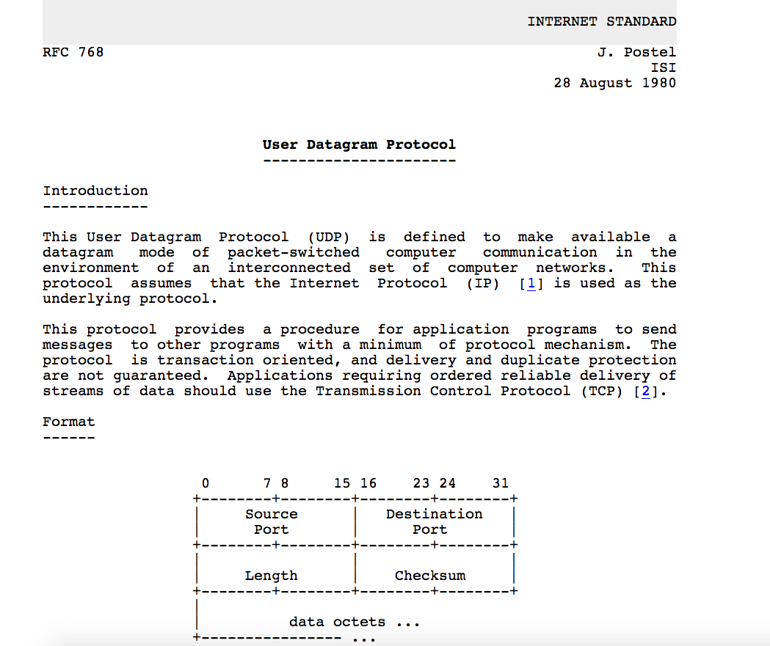
UDP: User Datagram Protocol [RFC 768]
Notes:
This slide marks the transition from the high-level idea of UDP to its actual segment format.
The important message is that UDP is deliberately small and simple.
Students should be prepared to read the header fields and understand why such a lightweight protocol still needs some structure.

Slide 27
UDP: Transport Layer Actions
SNMP client
SNMP server
application
application
transport
(UDP)
transport
(UDP)
network (IP)
network (IP)
link
link
physical
physical
Notes:
This slide begins the sender/receiver action view for UDP using an SNMP example.
The diagram emphasizes that UDP still follows the same overall transport idea: application data is wrapped with a transport header and passed through IP.
Students should see that even a simple protocol like UDP still performs defined transport actions at both ends.

Slide 28
UDP: Transport Layer Actions
SNMP client
SNMP server
UDP sender actions:
application
application
is passed an application-layer message
SNMP msg
transport
(UDP)
transport
(UDP)
determines UDP segment header fields values
UDP_{h}
SNMP msg
UDP_{h}
creates UDP segment
network (IP)
network (IP)
passes segment to IP
link
link
physical
physical
Notes:
This slide focuses on UDP sender actions. The sender takes the application message, determines the UDP header values, creates the segment, and passes it to IP.
The process is conceptually simple, and that simplicity is one reason UDP can be efficient.
Students should compare this with the earlier generic transport sender actions and notice how little extra state UDP needs.

Slide 29
UDP: Transport Layer Actions
SNMP client
SNMP server
UDP receiver actions:
application
receives segment from IP
application
checks UDP checksum header value
transport
(UDP)
transport
(UDP)
SNMP msg
extracts application-layer message
network (IP)
network (IP)
SNMP msg
UDP_{h}
demultiplexes message up to application via socket
link
link
physical
physical
Notes:
This slide focuses on UDP receiver actions. The receiver gets the segment from IP, checks the UDP checksum, extracts the application message, and delivers it upward to the socket.
There is no connection state or complex recovery logic here.
Students should understand that UDP keeps the receiver-side job small, but that simplicity shifts responsibility to the application when stronger guarantees are needed.

Slide 30
UDP segment header
32 bits
source port #
dest port #
length
checksum
application
data
(payload)
length, in bytes of UDP segment, including header
data to/from application layer
UDP segment format
Notes:
This slide presents the UDP segment format. The main fields are source port, destination port, length, and checksum.
The header is small, which fits UDP's lightweight design philosophy.
Students should know what each field is used for and why the header is much smaller than TCP's header.

Slide 31

UDP checksum
Goal: detect errors (i.e., flipped bits) in transmitted segment
1st number
2nd number
sum
Transmitted: 5 6 11
Received: 4 6 11
receiver-computed
checksum
=
sender-computed
checksum (as received)
Notes:
This slide introduces the goal of the UDP checksum: error detection.
The checksum helps detect bit errors that may have occurred in transmission. It does not guarantee absolute protection, but it provides a useful integrity check.
Students should understand the checksum as a detection mechanism, not a full correction mechanism.

Slide 32
UDP checksum
Goal: detect errors (i.e., flipped bits) in transmitted segment
sender:
treat contents of UDP segment (including UDP header fields and IP addresses) as sequence of 16-bit integers
checksum: addition (one’s complement sum) of segment content
checksum value put into UDP checksum field
receiver:
compute checksum of received segment
check if computed checksum equals checksum field value:
Not equal - error detected
Equal - no error detected. But maybe errors nonetheless? More later ….
Notes:
This slide explains how the UDP checksum is computed. The sender treats content as 16-bit words, computes the one's-complement sum, and places the result in the checksum field.
The receiver performs the same calculation and compares the result.
Students should focus on the logical steps rather than on memorizing every arithmetic detail.

Slide 33
Internet checksum: an example
example: add two 16-bit integers
1 1 1 0 0 1 1 0 0 1 1 0 0 1 1 0
1 1 0 1 0 1 0 1 0 1 0 1 0 1 0 1
wraparound
1 1 0 1 1 1 0 1 1 1 0 1 1 1 0 1 1
sum
1 0 1 1 1 0 1 1 1 0 1 1 1 1 0 0
checksum
0 1 0 0 0 1 0 0 0 1 0 0 0 0 1 1
Note: when adding numbers, a carryout from the most significant bit needs to be added to the result
* Check out the online interactive exercises for more examples: http://gaia.cs.umass.edu/kurose_ross/interactive/
Notes:
This slide gives an Internet checksum example. It shows how 16-bit words are added and how carry bits wrap around.
Worked examples are important because checksum arithmetic can feel abstract until it is seen step by step.
Students should practice at least one example by hand to gain confidence.

Slide 34
Internet checksum: weak protection!
example: add two 16-bit integers
0 1
1 1 1 0 0 1 1 0 0 1 1 0 0 1 1 0
1 0
1 1 0 1 0 1 0 1 0 1 0 1 0 1 0 1
wraparound
1 1 0 1 1 1 0 1 1 1 0 1 1 1 0 1 1
Even though numbers have changed (bit flips), no change in checksum!
sum
1 0 1 1 1 0 1 1 1 0 1 1 1 1 0 0
checksum
0 1 0 0 0 1 0 0 0 1 0 0 0 0 1 1
Notes:
This slide points out that the Internet checksum is only weak protection. Some changed bit patterns can still produce the same checksum.
That means an unchanged checksum does not prove perfection; it only suggests that no error was detected by this method.
Students should remember that checksums are practical tools, not magic guarantees.

Slide 35
Summary: UDP
“no frills” protocol:
segments may be lost, delivered out of order
best effort service: “send and hope for the best”
UDP has its plusses:
no setup/handshaking needed (no RTT incurred)
can function when network service is compromised
helps with reliability (checksum)
build additional functionality on top of UDP in application layer (e.g., HTTP/3)
Notes:
This summary slide closes the UDP section. UDP is a simple, low-overhead, best-effort transport protocol with checksum-based error detection.
Its strengths are simplicity, speed, and flexibility. Its limitations are lack of built-in reliability, ordering, and congestion control.
Students should be able to explain not only what UDP lacks, but why some applications still prefer it.

Slide 36
Chapter 3: roadmap
Transport-layer services
Multiplexing and demultiplexing
Connectionless transport: UDP
Principles of reliable data transfer
Connection-oriented transport: TCP
Principles of congestion control
TCP congestion control
Evolution of transport-layer functionality
Notes:
This roadmap slide begins the reliable data transfer section.
The chapter is now moving from simple transport service to the deeper question of how reliability can be built over an unreliable channel.
Students should expect more abstract protocol reasoning from this point onward, especially with finite-state machines.

Slide 37
Principles of reliable data transfer
sending process
receiving process
application
data
data
transport
reliable channel
reliable service abstraction
Notes:
This slide introduces reliable data transfer as an abstraction. From the application point of view, data should move over a reliable channel.
That abstraction is useful because applications would prefer not to manage every transmission problem themselves.
Students should understand that protocols often begin as desired abstractions before implementation details are considered.

Slide 38
Principles of reliable data transfer
sending process
receiving process
sending process
receiving process
application
data
data
application
data
data
transport
transport
reliable channel
sender-side of
reliable data transfer protocol
receiver-side
of reliable data transfer protocol
reliable service abstraction
transport
network
unreliable channel
reliable service implementation
Notes:
This slide shows the implementation viewpoint. A reliable service must actually be built over an unreliable lower-level channel.
That is the central problem of reliable data transfer design.
Students should notice the gap between the clean service abstraction and the messy reality of channel behavior.

Slide 39
Principles of reliable data transfer
sending process
receiving process
application
data
data
transport
sender-side of
reliable data transfer protocol
receiver-side
of reliable data transfer protocol
Complexity of reliable data transfer protocol will depend (strongly) on characteristics of unreliable channel (lose, corrupt, reorder data?)
transport
network
unreliable channel
reliable service implementation
Notes:
This slide explains that the complexity of a reliable protocol depends heavily on the properties of the underlying unreliable channel.
If the channel can corrupt, lose, or reorder packets, the protocol must add mechanisms to handle those cases.
Students should see protocol design as a response to channel assumptions.

Slide 40

Principles of reliable data transfer
sending process
receiving process
application
data
data
transport
sender-side of
reliable data transfer protocol
receiver-side
of reliable data transfer protocol
Sender, receiver do not know the “state” of each other, e.g., was a message received?
unless communicated via a message
transport
network
unreliable channel
reliable service implementation
Notes:
This slide highlights the importance of state and feedback. The sender and receiver cannot automatically know each other's state unless they exchange messages about it.
That is why acknowledgments and protocol logic are necessary.
Students should understand that reliability depends on communication about communication.

Slide 41
Reliable data transfer protocol (rdt): interfaces
rdt_send(): called from above, (e.g., by app.). Passed data to deliver to receiver upper layer
deliver_data(): called by rdt to deliver data to upper layer
sending process
receiving process
rdt_send()
data
data
deliver_data()
data
sender-side
implementation of rdt reliable data transfer protocol
receiver-side
implementation of rdt reliable data transfer protocol
packet
udt_send()
Header
data
Header
data
rdt_rcv()
unreliable channel
udt_send(): called by rdt
to transfer packet over
unreliable channel to receiver
rdt_rcv(): called when packet arrives on receiver side of channel
Bi-directional communication over unreliable channel
Notes:
This slide introduces the interface of a reliable data transfer protocol, including calls such as rdt_send, udt_send, rdt_rcv, and deliver_data.
These interfaces separate the service seen by the application from the behavior used inside the protocol.
Students should understand what is called from above, what is called from below, and why this separation is useful.

Slide 42
Reliable data transfer: getting started
We will:
incrementally develop sender, receiver sides of reliable data transfer protocol (rdt)
consider only unidirectional data transfer
but control info will flow in both directions!
use finite state machines (FSM) to specify sender, receiver
event causing state transition
actions taken on state transition
state: when in this “state” next state uniquely determined by next event
state
1
state
2
event
actions
Notes:
This slide explains why finite-state machines are used to describe reliable data transfer protocols.
A protocol changes behavior depending on events, and FSM notation makes those transitions explicit.
Students should be comfortable reading state, event, action, and transition labels because they will appear repeatedly in later slides.

Slide 43

rdt1.0: reliable transfer over a reliable channel
underlying channel perfectly reliable
no bit errors
no loss of packets
separate FSMs for sender, receiver:
sender sends data into underlying channel
receiver reads data from underlying channel
Wait for call from above
rdt_send(data)
Wait for call from below
rdt_rcv(packet)
sender
packet = make_pkt(data)
udt_send(packet)
receiver
extract (packet,data)
deliver_data(data)
Notes:
This slide presents rdt1.0, reliable transfer over a perfectly reliable channel.
Because the channel neither loses nor corrupts packets, the protocol is extremely simple. The sender sends, and the receiver delivers.
Students should treat this as the baseline case that later versions will complicate when realism is added.

Slide 44
rdt2.0: channel with bit errors
underlying channel may flip bits in packet
checksum (e.g., Internet checksum) to detect bit errors
the question: how to recover from errors?
How do humans recover from “errors” during conversation?
Notes:
This slide introduces rdt2.0, where the channel can now corrupt bits.
Once corruption is possible, the question becomes how to detect the error and how to recover from it.
Students should see this as the moment when checksums alone stop being enough and control feedback becomes necessary.

Slide 45
rdt2.0: channel with bit errors
underlying channel may flip bits in packet
checksum to detect bit errors
the question: how to recover from errors?
acknowledgements (ACKs): receiver explicitly tells sender that pkt received OK
negative acknowledgements (NAKs): receiver explicitly tells sender that pkt had errors
sender retransmits pkt on receipt of NAK
stop and wait
sender sends one packet, then waits for receiver response
Notes:
This slide adds ACK and NAK to the corrupted-channel problem.
The receiver can explicitly say whether a packet was received correctly. The sender then retransmits when necessary.
Students should recognize the stop-and-wait pattern here: send one packet, then wait for the receiver's response.

Slide 46
rdt2.0: FSM specifications
rdt_send(data)
snkpkt = make_pkt(data, checksum)
udt_send(sndpkt)
rdt_rcv(rcvpkt) &&
isNAK(rcvpkt)
sender
Wait for call from above
Wait for ACK or NAK
udt_send(sndpkt)
rdt_rcv(rcvpkt) && corrupt(rcvpkt)
udt_send(NAK)
rdt_rcv(rcvpkt) && isACK(rcvpkt)
Wait for call from below
Λ
receiver
rdt_rcv(rcvpkt) && notcorrupt(rcvpkt)
extract(rcvpkt,data)
deliver_data(data)
udt_send(ACK)
Notes:
This slide gives the FSM specification of rdt2.0. The sender and receiver each react to events such as correct receipt, corruption, ACK, and NAK.
The value of this slide is not just the specific protocol, but the method of expressing protocol logic precisely.
Students should practice reading the sender and receiver FSM separately.

Slide 47
rdt2.0: FSM specification
rdt_send(data)
snkpkt = make_pkt(data, checksum)
udt_send(sndpkt)
rdt_rcv(rcvpkt) &&
isNAK(rcvpkt)
sender
Wait for call from above
Wait for ACK or NAK
isNAK(rcvpkt)
udt_send(sndpkt)
rdt_rcv(rcvpkt) && corrupt(rcvpkt)
udt_send(NAK)
rdt_rcv(rcvpkt) && isACK(rcvpkt)
isACK(rcvpkt)
Wait for call from below
Λ
receiver
Note: “state” of receiver (did the receiver get my message correctly?) isn’t known to sender unless somehow communicated from receiver to sender
that’s why we need a protocol!
rdt_rcv(rcvpkt) && notcorrupt(rcvpkt)
extract(rcvpkt,data)
deliver_data(data)
udt_send(ACK)
Notes:
This slide explains why protocol state matters. The sender cannot know what happened at the receiver unless it is informed somehow.
That uncertainty is exactly why explicit acknowledgment logic exists.
Students should understand that reliability problems are really problems of missing information and delayed information.

Slide 48
rdt2.0: operation with no errors
rdt_send(data)
snkpkt = make_pkt(data, checksum)
udt_send(sndpkt)
rdt_rcv(rcvpkt) &&
isNAK(rcvpkt)
sender
Wait for call from above
Wait for ACK or NAK
udt_send(sndpkt)
rdt_rcv(rcvpkt) && corrupt(rcvpkt)
udt_send(NAK)
rdt_rcv(rcvpkt) && isACK(rcvpkt)
Wait for call from below
Λ
receiver
rdt_rcv(rcvpkt) && notcorrupt(rcvpkt)
extract(rcvpkt,data)
deliver_data(data)
udt_send(ACK)
Notes:
This slide shows rdt2.0 operating when no errors occur.
The exchange looks simple: send, receive, ACK, continue. This is the ideal successful case under the bit-error model.
Students should compare this with the later error scenarios to see how the protocol changes under failure.

Slide 49
rdt2.0: corrupted packet scenario
rdt_send(data)
snkpkt = make_pkt(data, checksum)
udt_send(sndpkt)
rdt_rcv(rcvpkt) &&
isNAK(rcvpkt)
sender
Wait for call from above
Wait for ACK or NAK
udt_send(sndpkt)
rdt_rcv(rcvpkt) && corrupt(rcvpkt)
udt_send(NAK)
rdt_rcv(rcvpkt) && isACK(rcvpkt)
Wait for call from below
Λ
receiver
rdt_rcv(rcvpkt) && notcorrupt(rcvpkt)
extract(rcvpkt,data)
deliver_data(data)
udt_send(ACK)
Notes:
This slide shows rdt2.0 when a packet is corrupted.
The receiver detects the corruption and sends a NAK, causing the sender to retransmit.
Students should see that the protocol can recover from data corruption, but the next slides will show that this is still not enough.

Slide 50
rdt2.0 has a fatal flaw!
what happens if ACK/NAK corrupted?
sender doesn’t know what happened at receiver!
can’t just retransmit: possible duplicate
handling duplicates:
sender retransmits current pkt if ACK/NAK corrupted
sender adds sequence number to each pkt
receiver discards (doesn’t deliver up) duplicate pkt
stop and wait
sender sends one packet, then waits for receiver response
Notes:
This slide points out the fatal flaw of rdt2.0: what if the ACK or NAK itself is corrupted?
Now the sender becomes uncertain again and may retransmit, creating possible duplicates. Sequence numbers are introduced to solve this ambiguity.
Students should understand why correctness requires packets to be identifiable, not just acknowledged.

Slide 51
rdt2.1: sender, handling garbled ACK/NAKs
rdt_send(data)
sndpkt = make_pkt(0, data, checksum)
udt_send(sndpkt)
rdt_rcv(rcvpkt) && (corrupt(rcvpkt) ||
isNAK(rcvpkt) )
Wait for call 0 from above
Wait for ACK or NAK 0
udt_send(sndpkt)
rdt_rcv(rcvpkt)
&& notcorrupt(rcvpkt) && isACK(rcvpkt)
rdt_rcv(rcvpkt)
&& notcorrupt(rcvpkt)
&& isACK(rcvpkt)
Λ
Λ
Wait for ACK or NAK 1
Wait for
call 1 from above
rdt_rcv(rcvpkt)
&& (corrupt(rcvpkt) ||
isNAK(rcvpkt) )
rdt_send(data)
udt_send(sndpkt)
sndpkt = make_pkt(1, data, checksum)
udt_send(sndpkt)
Notes:
This slide presents the sender side of rdt2.1, which adds sequence numbers.
The sender now alternates sequence numbers and reacts not only to ACK/NAK but also to corruption in feedback.
Students should focus on the idea that sequence numbers let the sender and receiver distinguish new packets from duplicates.

Slide 52
rdt2.1: receiver, handling garbled ACK/NAKs
rdt_rcv(rcvpkt) && notcorrupt(rcvpkt)
&& has_seq0(rcvpkt)
extract(rcvpkt,data)
deliver_data(data)
sndpkt = make_pkt(ACK, chksum)
udt_send(sndpkt)
rdt_rcv(rcvpkt) && (corrupt(rcvpkt)
rdt_rcv(rcvpkt) && (corrupt(rcvpkt)
sndpkt = make_pkt(NAK, chksum)
udt_send(sndpkt)
sndpkt = make_pkt(NAK, chksum)
udt_send(sndpkt)
Wait for
0 from below
Wait for
1 from below
rdt_rcv(rcvpkt) &&
not corrupt(rcvpkt) &&
has_seq1(rcvpkt)
rdt_rcv(rcvpkt) &&
not corrupt(rcvpkt) &&
has_seq0(rcvpkt)
sndpkt = make_pkt(ACK, chksum)
udt_send(sndpkt)
sndpkt = make_pkt(ACK, chksum)
udt_send(sndpkt)
rdt_rcv(rcvpkt) && notcorrupt(rcvpkt)
&& has_seq1(rcvpkt)
extract(rcvpkt,data)
deliver_data(data)
sndpkt = make_pkt(ACK, chksum)
udt_send(sndpkt)
Notes:
This slide presents the receiver side of rdt2.1.
The receiver tracks which sequence number it expects, delivers correct in-order packets, and responds appropriately when duplicates or corruption appear.
Students should compare the receiver states carefully because expected sequence number is now part of the protocol state.

Slide 53
rdt2.1: discussion
sender:
seq # added to pkt
two seq. #s (0,1) will suffice. Why?
must check if received ACK/NAK corrupted
twice as many states
state must “remember” whether “expected” pkt should have seq # of 0 or 1
receiver:
must check if received packet is duplicate
state indicates whether 0 or 1 is expected pkt seq #
note: receiver can not know if its last ACK/NAK received OK at sender
Notes:
This slide summarizes the logic of rdt2.1. Only two sequence numbers, 0 and 1, are needed because this is a stop-and-wait protocol.
The sender and receiver must each remember which packet number is current or expected.
Students should connect this with the idea that protocol state is memory about what happened last.

Slide 54
rdt2.2: a NAK-free protocol
same functionality as rdt2.1, using ACKs only
instead of NAK, receiver sends ACK for last pkt received OK
receiver must explicitly include seq # of pkt being ACKed
duplicate ACK at sender results in same action as NAK: retransmit current pkt
As we will see, TCP uses this approach to be NAK-free
Notes:
This slide introduces rdt2.2, a NAK-free protocol.
Instead of sending NAK, the receiver sends an ACK for the last correctly received packet. Duplicate ACKs can then play the role of negative feedback.
Students should note that this idea is important because real TCP also avoids explicit NAK in its classic design.

Slide 55
rdt2.2: sender, receiver fragments
rdt_send(data)
sndpkt = make_pkt(0, data, checksum)
udt_send(sndpkt)
rdt_rcv(rcvpkt) &&
( corrupt(rcvpkt) ||
isACK(rcvpkt,1) )
Wait for call 0 from above
Wait for ACK
0
udt_send(sndpkt)
sender FSM
fragment
rdt_rcv(rcvpkt)
&& notcorrupt(rcvpkt)
&& isACK(rcvpkt,0)
rdt_rcv(rcvpkt) &&
(corrupt(rcvpkt) ||
has_seq1(rcvpkt))
Λ
Wait for
0 from below
receiver FSM
fragment
udt_send(sndpkt)
rdt_rcv(rcvpkt) && notcorrupt(rcvpkt)
&& has_seq1(rcvpkt)
extract(rcvpkt,data)
deliver_data(data)
sndpkt = make_pkt(ACK1, chksum)
udt_send(sndpkt)
Notes:
This slide shows fragments of the sender and receiver FSM for rdt2.2.
The main lesson is that reliability can be achieved using only ACKs, provided sequence numbers and duplicate-handling logic are in place.
Students should compare this design with rdt2.1 and notice what has been simplified.

Slide 56
rdt3.0: channels with errors and loss
New channel assumption: underlying channel can also lose packets (data, ACKs)
checksum, sequence #s, ACKs, retransmissions will be of help … but not quite enough
Q: How do humans handle lost sender-to-receiver words in conversation?
Notes:
This slide moves to rdt3.0 by adding packet loss to the model.
Checksums, ACKs, and sequence numbers are still helpful, but they are no longer enough by themselves because a lost packet creates silence rather than an explicit signal.
Students should understand that timeout now becomes necessary.

Slide 57
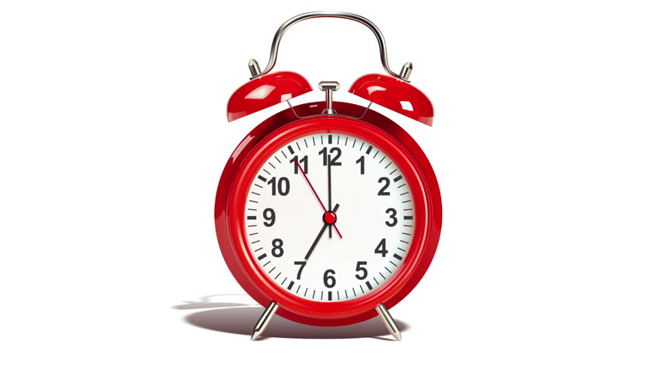
rdt3.0: channels with errors and loss
Approach: sender waits “reasonable” amount of time for ACK
retransmits if no ACK received in this time
if pkt (or ACK) just delayed (not lost):
retransmission will be duplicate, but seq #s already handles this!
receiver must specify seq # of packet being ACKed
use countdown timer to interrupt after “reasonable” amount of time
timeout
Notes:
This slide introduces the timeout idea for channels with both errors and loss.
The sender waits a reasonable amount of time for an ACK and retransmits if no ACK arrives. Delayed packets or ACKs are handled through sequence numbers.
Students should see timeout as the protocol's way of acting when the channel does not provide explicit feedback.

Slide 58
rdt3.0 sender
rdt_send(data)
sndpkt = make_pkt(0, data, checksum)
udt_send(sndpkt)
start_timer
Wait for
call 0 from above
Wait for ACK0
rdt_rcv(rcvpkt)
&& notcorrupt(rcvpkt)
&& isACK(rcvpkt,1)
rdt_rcv(rcvpkt)
&& notcorrupt(rcvpkt)
&& isACK(rcvpkt,0)
stop_timer
stop_timer
Wait for ACK1
Wait for
call 1 from above
rdt_send(data)
sndpkt = make_pkt(1, data, checksum)
udt_send(sndpkt)
start_timer
Notes:
This slide shows the rdt3.0 sender FSM in one of its key states.
The sender starts a timer after transmission and stops it when the expected ACK arrives correctly.
Students should understand timer management as a central mechanism of reliable transport.

Slide 59
rdt3.0 sender
rdt_send(data)
rdt_rcv(rcvpkt) &&
( corrupt(rcvpkt) ||
isACK(rcvpkt,1) )
sndpkt = make_pkt(0, data, checksum)
udt_send(sndpkt)
start_timer
rdt_rcv(rcvpkt)
Λ
Λ
Wait for
call 0 from above
Wait for ACK0
timeout
udt_send(sndpkt)
start_timer
rdt_rcv(rcvpkt)
&& notcorrupt(rcvpkt)
&& isACK(rcvpkt,1)
rdt_rcv(rcvpkt)
&& notcorrupt(rcvpkt)
&& isACK(rcvpkt,0)
stop_timer
stop_timer
Wait for ACK1
Wait for
call 1 from above
timeout
udt_send(sndpkt)
start_timer
rdt_rcv(rcvpkt)
rdt_send(data)
Λ
rdt_rcv(rcvpkt) &&
( corrupt(rcvpkt) ||
isACK(rcvpkt,0) )
sndpkt = make_pkt(1, data, checksum)
udt_send(sndpkt)
start_timer
Λ
Notes:
This slide continues the rdt3.0 sender FSM by showing the timeout transition.
If the ACK does not arrive in time, the sender retransmits the packet and restarts the timer.
Students should compare this with earlier versions and notice that loss recovery is now explicit in the FSM.

Slide 60

rdt3.0 in action
sender
receiver
sender
receiver
send pkt0
pkt0
send pkt0
pkt0
rcv pkt0
rcv pkt0
ack0
send ack0
ack0
send ack0
rcv ack0
rcv ack0
send pkt1
pkt1
send pkt1
pkt1
rcv pkt1
X
ack1
send ack1
loss
rcv ack1
send pkt0
pkt0
rcv pkt0
timeout
resend pkt1
ack0
send ack0
pkt1
rcv pkt1
ack1
send ack1
rcv ack1
send pkt0
pkt0
(a) no loss
rcv pkt0
ack0
send ack0
(b) packet loss
Notes:
This slide shows rdt3.0 in action under normal delivery and packet-loss scenarios.
The timeline helps students see how timeouts and retransmissions behave in practice.
Students should use this slide to connect the formal FSM with real packet flow.

Slide 61
rdt3.0 in action
sender
receiver
sender
receiver
send pkt0
pkt0
rcv pkt0
send pkt0
pkt0
send ack0
rcv pkt0
rcv ack0
ack0
ack0
send ack0
send pkt1
pkt1
rcv ack0
rcv pkt1
send pkt1
pkt1
send ack1
rcv pkt1
ack1
ack1
send ack1
X
timeout
resend pkt1
loss
pkt1
rcv pkt1
timeout
resend pkt1
rcv ack1
(detect duplicate)
pkt1
rcv pkt1
send ack1
send pkt0
pkt0
ack1
(detect duplicate)
rcv pkt0
rcv ack1
send ack1
rcv ack1
ack1
ack0
send ack0
send pkt0
pkt0
(ignore)
rcv pkt0
ack0
send ack0
pkt1
(c) ACK loss
(d) premature timeout/ delayed ACK
Notes:
This slide continues the rdt3.0 action examples by showing ACK loss and premature timeout.
These examples are important because they show that the protocol must handle more than one kind of failure.
Students should notice how duplicate packets and duplicate ACKs arise naturally in such cases.

Slide 62
Performance of rdt3.0 (stop-and-wait)
U _{sender}: utilization – fraction of time sender busy sending
example: 1 Gbps link, 15 ms prop. delay, 8000 bit packet
time to transmit packet into channel:
L
8000 bits
D_{trans} =
=
=
8 microsecs
R
10⁹ bits/sec
Notes:
This slide evaluates the performance of rdt3.0 under stop-and-wait assumptions.
Even on a fast link, sender utilization can be very poor when propagation delay is large compared with transmission time.
Students should understand that a correct protocol is not automatically an efficient one.

Slide 63
rdt3.0: stop-and-wait operation
sender
receiver
first packet bit transmitted, t = 0
first packet bit arrives
RTT
last packet bit arrives, send ACK
ACK arrives, send next
packet, t = RTT + L / R
Notes:
This slide shows the stop-and-wait timeline more explicitly.
Only one packet is in flight at a time, so a large amount of time is spent waiting rather than sending.
Students should connect this picture directly to the low utilization formulas.

Slide 64
rdt3.0: stop-and-wait operation
sender
receiver
L / R
=
L/R
U_{sender}
RTT
+ L / R
.008
RTT
=
30.008
=
0.00027
rdt 3.0 protocol performance stinks!
Protocol limits performance of underlying infrastructure (channel)
Notes:
This slide concludes that rdt3.0 with stop-and-wait performs poorly on high-speed or long-delay paths.
The protocol limits the infrastructure because the sender stays idle too often.
Students should see this as the motivation for pipelining.

Slide 65
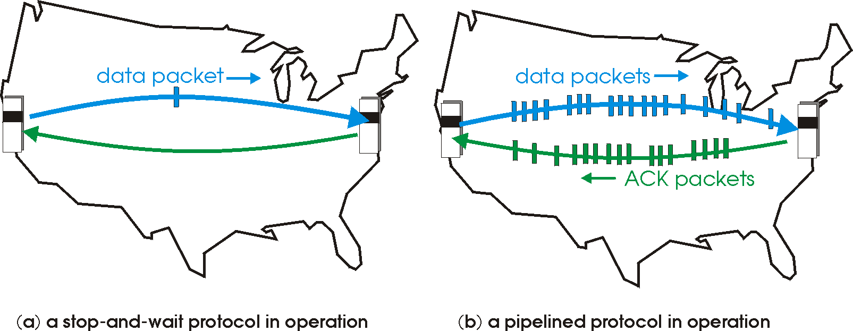
rdt3.0: pipelined protocols operation
pipelining: sender allows multiple, “in-flight”, yet-to-be-acknowledged packets
range of sequence numbers must be increased
buffering at sender and/or receiver
Notes:
This slide introduces pipelined protocols.
Instead of waiting for one packet to be acknowledged before sending the next, the sender allows multiple packets to be in flight.
Students should understand that pipelining improves efficiency but requires larger sequence spaces and buffering.

Slide 66
Pipelining: increased utilization
sender
receiver
first packet bit transmitted, t = 0
last bit transmitted, t = L / R
first packet bit arrives
RTT
last packet bit arrives, send ACK
last bit of 2nd packet arrives, send ACK
last bit of 3rd packet arrives, send ACK
ACK arrives, send next
packet, t = RTT + L / R
3-packet pipelining increases
utilization by a factor of 3!
Notes:
This slide shows how pipelining increases utilization.
By keeping more than one packet in transit, the sender uses the link more effectively and wastes less time waiting.
Students should read this as the performance argument for moving beyond stop-and-wait.

Slide 67
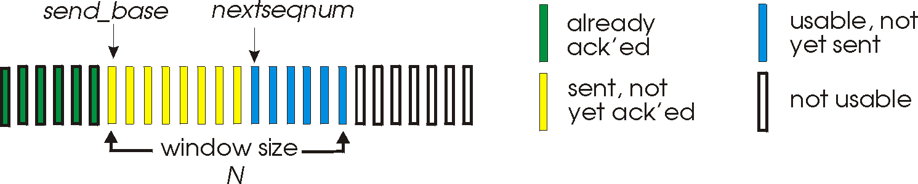
Go-Back-N: sender
sender: “window” of up to N, consecutive transmitted but unACKed pkts
k-bit seq # in pkt header
cumulative ACK: ACK(n): ACKs all packets up to, including seq # n
on receiving ACK(n): move window forward to begin at n+1
timer for oldest in-flight packet
timeout(n): retransmit packet n and all higher seq # packets in window
Notes:
This slide introduces Go-Back-N from the sender perspective.
The sender maintains a window of unacknowledged packets and uses cumulative acknowledgments. If a timeout occurs for the oldest unacknowledged packet, the sender retransmits that packet and all later packets in the window.
Students should understand the sender window as the heart of the GBN idea.

Slide 68
Go-Back-N: receiver
ACK-only: always send ACK for correctly-received packet so far, with highest in-order seq #
may generate duplicate ACKs
need only remember rcv_base
on receipt of out-of-order packet:
can discard (don’t buffer) or buffer: an implementation decision
re-ACK pkt with highest in-order seq #
Receiver view of sequence number space:
received and ACKed
…
…
Out-of-order: received but not ACKed
rcv_base
Not received
Notes:
This slide gives the Go-Back-N receiver perspective.
The receiver acknowledges the highest in-order packet received so far and may discard or ignore out-of-order packets, depending on implementation choice.
Students should recognize that the receiver logic is simpler than in Selective Repeat because it focuses on in-order progress.

Slide 69
Go-Back-N in action
sender window (N=4)
sender
receiver
0 1 2 3 4 5 6 7 8
send pkt0
send pkt1
send pkt2
send pkt3
(wait)
0 1 2 3 4 5 6 7 8
receive pkt0, send ack0
receive pkt1, send ack1
receive pkt3, discard,
(re)send ack1
0 1 2 3 4 5 6 7 8
X
0 1 2 3 4 5 6 7 8
loss
0 1 2 3 4 5 6 7 8
rcv ack0, send pkt4
0 1 2 3 4 5 6 7 8
rcv ack1, send pkt5
receive pkt4, discard,
(re)send ack1
ignore duplicate ACK
receive pkt5, discard,
(re)send ack1
pkt 2 timeout
0 1 2 3 4 5 6 7 8
send pkt2
send pkt3
send pkt4
send pkt5
0 1 2 3 4 5 6 7 8
0 1 2 3 4 5 6 7 8
rcv pkt2, deliver, send ack2
rcv pkt3, deliver, send ack3
rcv pkt4, deliver, send ack4
rcv pkt5, deliver, send ack5
0 1 2 3 4 5 6 7 8
Notes:
This slide shows Go-Back-N in action.
One lost packet can cause multiple later packets to be retransmitted even if they were sent successfully the first time.
Students should see both the simplicity and the inefficiency of GBN in this picture.

Slide 70
Selective repeat
receiver individually acknowledges all correctly received packets
buffers packets, as needed, for eventual in-order delivery to upper layer
sender times-out/retransmits individually for unACKed packets
sender maintains timer for each unACKed pkt
sender window
N consecutive seq #s
limits seq #s of sent, unACKed packets
Notes:
This slide introduces Selective Repeat.
Unlike GBN, Selective Repeat allows the receiver to acknowledge individual packets and buffer out-of-order packets. The sender also retransmits lost packets individually.
Students should see Selective Repeat as more efficient but also more complex.

Slide 71
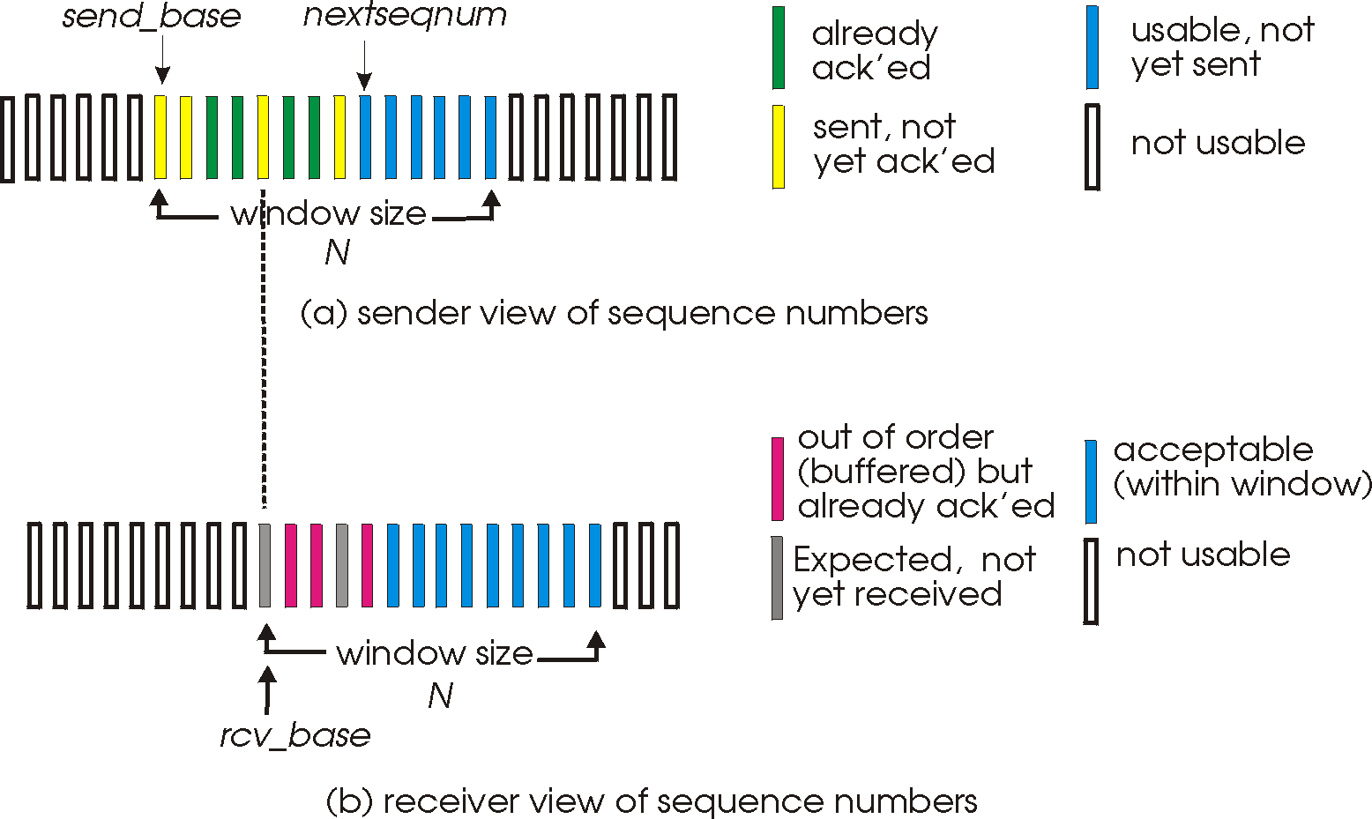
Selective repeat: sender, receiver windows
Notes:
This slide presents the sender and receiver windows for Selective Repeat.
The window idea remains, but now both sides track more detailed information about which packets have been sent, received, buffered, or acknowledged.
Students should carefully compare this with the simpler GBN view.

Slide 72
Selective repeat: sender and receiver
sender
receiver
data from above:
if next available seq # in window, send packet
timeout(n):
resend packet n, restart timer
ACK(n) in [sendbase,sendbase+N]:
mark packet n as received
if n smallest unACKed packet, advance window base to next unACKed seq #
packet n in [rcvbase, rcvbase+N-1]
send ACK(n)
out-of-order: buffer
in-order: deliver (also deliver buffered, in-order packets), advance window to next not-yet-received packet
packet n in [rcvbase-N,rcvbase-1]
ACK(n)
otherwise:
ignore
Notes:
This slide explains the rules of Selective Repeat for sender and receiver behavior.
The sender marks packets individually and advances its window when possible. The receiver buffers valid out-of-order packets and delivers data when in-order progress can be made.
Students should focus on the increased bookkeeping complexity that comes with higher efficiency.

Slide 73
Selective Repeat in action
sender window (N=4)
sender
receiver
0 1 2 3 4 5 6 7 8
send pkt0
send pkt1
send pkt2
send pkt3
(wait)
0 1 2 3 4 5 6 7 8
receive pkt0, send ack0
receive pkt1, send ack1
receive pkt3, buffer,
send ack3
0 1 2 3 4 5 6 7 8
X
0 1 2 3 4 5 6 7 8
loss
0 1 2 3 4 5 6 7 8
rcv ack0, send pkt4
0 1 2 3 4 5 6 7 8
rcv ack1, send pkt5
receive pkt4, buffer,
send ack4
record ack3 arrived
receive pkt5, buffer,
send ack5
pkt 2 timeout
0 1 2 3 4 5 6 7 8
send pkt2
(but not 3,4,5)
0 1 2 3 4 5 6 7 8
0 1 2 3 4 5 6 7 8
rcv pkt2; deliver pkt2,
pkt3, pkt4, pkt5; send ack2
0 1 2 3 4 5 6 7 8
Q: what happens when ack2 arrives?
Notes:
This slide shows Selective Repeat in action.
Because packets are retransmitted individually and out-of-order packets can be buffered, fewer unnecessary retransmissions occur than in GBN.
Students should see this as the practical payoff of the more complex design.

Slide 74
Selective repeat: a dilemma!
sender window
(after receipt)
receiver window
(after receipt)
0 1 2 3 0 1 2
pkt0
0 1 2 3 0 1 2
pkt1
0 1 2 3 0 1 2
0 1 2 3 0 1 2
pkt2
0 1 2 3 0 1 2
example:
seq #s: 0, 1, 2, 3 (base 4 counting)
window size=3
0 1 2 3 0 1 2
0 1 2 3 0 1 2
pkt3
X
0 1 2 3 0 1 2
pkt0
will accept packet
with seq number 0
(a) no problem
0 1 2 3 0 1 2
pkt0
0 1 2 3 0 1 2
pkt1
0 1 2 3 0 1 2
0 1 2 3 0 1 2
pkt2
X
0 1 2 3 0 1 2
X
0 1 2 3 0 1 2
X
timeout
retransmit pkt0
0 1 2 3 0 1 2
pkt0
will accept packet
with seq number 0
(b) oops!
Notes:
This slide introduces the Selective Repeat dilemma.
If sequence number space is too small relative to the window size, old packets can be mistaken for new packets after wraparound.
Students should understand that protocol correctness depends not just on the idea of a window, but also on the mathematical relationship between sequence space and window size.

Slide 75

Selective repeat: a dilemma!
sender window
(after receipt)
receiver window
(after receipt)
0 1 2 3 0 1 2
pkt0
0 1 2 3 0 1 2
pkt1
0 1 2 3 0 1 2
0 1 2 3 0 1 2
pkt2
0 1 2 3 0 1 2
example:
seq #s: 0, 1, 2, 3 (base 4 counting)
window size=3
0 1 2 3 0 1 2
0 1 2 3 0 1 2
pkt3
X
0 1 2 3 0 1 2
receiver can’t see sender side
receiver behavior identical in both cases!
something’s (very) wrong!
pkt0
will accept packet
with seq number 0
(a) no problem
Q: what relationship is needed between sequence # size and window size to avoid problem in scenario (b)?
pkt0
0 1 2 3 0 1 2
0 1 2 3 0 1 2
pkt1
0 1 2 3 0 1 2
0 1 2 3 0 1 2
pkt2
X
0 1 2 3 0 1 2
X
0 1 2 3 0 1 2
X
timeout
retransmit pkt0
0 1 2 3 0 1 2
pkt0
will accept packet
with seq number 0
(b) oops!
Notes:
This final slide asks the key question that resolves the Selective Repeat dilemma: what relationship must hold between sequence number space and window size?
The classic answer is that the window size must be no more than half of the sequence number space, so old packets cannot be confused with new ones after wraparound.
Students should leave this section understanding that transport protocol design depends on both logic and careful limits on parameter choices.

