Slide 1
Applied Sciences Faculty
Management Information Systems
Dr. Yakup BAKIŞ
Notes:
Hi everyone! My name is Yakup. I’ll be your instructor for Web Design and Programming

Slide 2
Chapter 1
Introduction to web development
Notes:
Before we continue, I want to ask a simple question:
How many of you use the Internet every day?
Today, we will start learning how to build the web, not just use it.
Good.
Today, we will start learning how to build the web,
not just how to use it.

Slide 3
Objectives
Applied
Load a web page from the Internet or an intranet into a web browser.
View the source code for a web page in a web browser.
Knowledge
Describe the components of a web application.
Distinguish between the Internet and an intranet.
Describe HTTP requests and responses.
Distinguish between the way a web server processes static web pages and dynamic web pages.
Notes:
In this lesson, our goal is to understand the basic structure of the web.
By the end of today, you should be able to:
describe the main components of a web application
understand the difference between the Internet and an intranet
explain HTTP requests and responses
distinguish static and dynamic web pages

Slide 4
Name the five major web browsers.
Describe the use of JavaScript.
Distinguish between HTML and CSS.
Explain how you deploy a website on the Internet.
Describe the components of an HTTP URL.
Describe these five web development issues: usability, cross-browser compatibility, user accessibility, search engine optimization, and Responsive Web Design.
Notes:
recognize major web browsers
and understand the roles of HTML, CSS, and JavaScript 2nd_Week_Understanding_the_Web_…
So today is mainly about understanding,
not heavy coding yet.

Slide 5
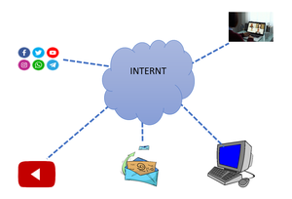
What is the Internet?
In 1995 the first connection was established over what is today known as the Internet. The internet provides a quick and easy exchange of information and is identified as the central tool in this Age of Information.
Notes:
Let’s begin with a fundamental question:
What is the Internet?
The Internet is a global network of interconnected computers
that allows fast and easy information exchange. 2nd_Week_Understanding_the_Web_…
It became the central communication system
of the modern information age.

Slide 6
The architecture of the Internet
Notes:
If we look at the diagram on page 6,
we see many LAN networks connected through WAN and exchange points.
This shows that the Internet is not a single computer,
but a huge network of networks working together.

Slide 7
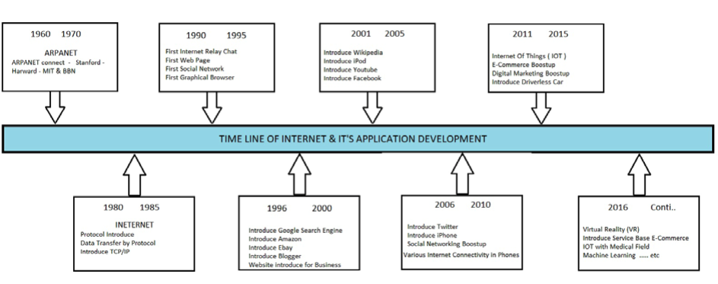
History of the Internet
Notes:
To understand web design,
we must first understand how the Internet evolved.
1960s — ARPANET: first research network
1980s — TCP/IP: standard communication protocols
1991 — World Wide Web: HTML, URLs, and browsers introduced
2000s — Web 2.0: interactive and social websites
Today — Mobile & Cloud: responsive, real-time web systems 2nd_Week_Understanding_the_Web_…
This evolution explains why modern web design exists today.

Slide 8
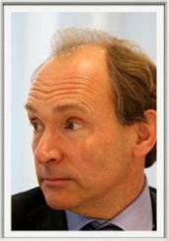
History of the Internet
1960s — ARPANET
          The first computer network created for research and communication.
1980s — TCP/IP
          Standard communication protocols connected different networks together.
1991 — World Wide Web (Tim Berners-Lee)
          The Web introduced HTML, URLs, and browsers.
2000s — Web 2.0
          Interactive websites, social media, user-generated content.
Today — Mobile & Cloud Web
          Responsive design, mobile devices, real-time applications.
Notes:
To understand web design, we first need to understand how the Internet evolved.
The Internet started in the 1960s as a research network called ARPANET.
In the 1980s, TCP/IP allowed different networks to communicate, forming the modern Internet.
1989 – Tim Berners Lee proposes at CERN a way to organise information using hyperlinks
In 1991, Tim Berners-Lee introduced the World Wide Web, including HTML, URLs, and the first web browser.
This moment is the real beginning of web design.
In the 2000s, Web 2.0 made websites interactive through JavaScript and user-generated content.
Today, the web is mobile, responsive, and cloud-based — and this course is about learning how to build for this modern web.

Slide 9
Understanding the Internet
The Internet is a medium for disseminating information:
World Wide Web - www
URLs – Uniform Resource Locator
Web servers
– A combination of compute hardware and software that that host the information for the World Wide Web
Sites
Pages
Web browsers
Internet service providers
Notes:
The Internet is the infrastructure,
but the Web is the system that lets us access information
through websites, pages, browsers, and servers. 2nd_Week_Understanding_the_Web_…
So when you open a browser,
you are actually using the Web on top of the Internet.

Slide 10
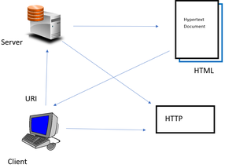
What is the Web?
The World Wide Web, or "Web" for short, is a massive collection of digital pages to access information over the internet. The World Wide Web(WWW) is an internet based service, which uses common set of rules known as Protocols, to distribute documents across the Internet in a standard way.
The Web is viewed through web software such as Google Chrome, Internet Explorer, Mozilla Firefox etc. The Web uses HTTP protocol, to transmit data and allows applicants to communicate in order to exchange business logic. Web documents also contain graphics, sounds, text and video.
Notes:
The World Wide Web is a large collection of digital documents
shared using common communication rules called protocols.
These documents can include:
text
images
sound
video
and they are viewed using web browsers

Slide 11
The components of a web application
Notes:
A web system has several key parts:
client devices like computers and phones
the Internet connection
and web servers that store and send data 2nd_Week_Understanding_the_Web_…
When you request a page,
the server sends HTML documents to your browser,
which then displays the website.
This simple idea is the foundation of the entire web.
The web is basically a global system of interconnected documents and resources. When you use a browser, you’re basically requesting documents from servers around the world, and these documents—often written in HTML—get displayed as the websites you interact with. So, in short, the web is how we access and share information on a massive scale.
Next, we break down the key components. We have browsers, which are like our window to the web. Servers store and send the information we request. Then, we have HTML, which is the language that structures what we see on each page. Together, these form the backbone of how the web works.

Slide 12
Website and Webpage
Webpage
A webpage is a single document or file containing content that is displayed in a web browser.
Website
A website is a collection of related web pages and other digital assets (such as images, videos, and interactive elements) that are hosted on a web server and accessible via the Internet.
Notes:
A webpage is a single document shown in a browser.
A website is a collection of related webpages and digital content
hosted on a server and accessible on the Internet

Slide 13
How the Web Works
1. Client (Browser)
    The client is any device or application that makes requests for services or resources from a server.
    The user enters a URL in a web browser.
    Common clients include web browsers (Chrome, Firefox, Safari), mobile apps, and email clients.
    2. Server
    The server is a machine or program that waits for requests from clients and then processes those requests to provide the required services. The request is sent to a web server.
    A server can host various services, such as websites (web servers), email services (email servers), file storage (file servers), and more. The server finds the requested files.
3. Response
    The server sends HTML, CSS, and JavaScript back.
    The browser renders the webpage on the screen.
Notes:
Let’s understand what really happens when you open a website.
First, you type a URL into your browser.
The browser acts as the client and sends a request to a server somewhere on the Internet.
The server processes this request and sends back the website’s files —
usually HTML for structure, CSS for design, and JavaScript for interaction.
Finally, the browser renders these files and displays the webpage on your screen.
This simple communication between client and server is the foundation of the entire web.

Slide 14
Browser → Server → HTML
Browser → Server → HTML

Slide 15
CANLI DEMO
https://www.w3schools.com/html/tryit.asp?filename=tryhtml_default
<!DOCTYPE html>
<html>
<head>
<title>My First Page</title>
</head>
<body>
<h1>Hello World</h1>
<p>This is my first web page.</p>
</body>
</html>
Notes:
we see a simple HTML structure:
<!DOCTYPE html>
<html>, <head>, <body>
a heading and a paragraph
This is the basic skeleton of every webpage. 2nd_Week_Understanding_the_Web_…
Next weeks,
we will start writing this code ourselves.

Slide 16
Difference Between The Internet and The Web
Feature | Internet | WWW
Definition | A global system of interconnected computer networks that use TCP/IP protocol to link devices worldwide. | A system of interlinked hypertext documents and multimedia content accessible via the Internet..
Scope | All types of digital communication such as gaming, chatting, file sharing, email, etc. | Specifically refers to the collection of web pages and websites accessible via web browsers.
Components | Hardware(servers, routers, devices), protocols(TCP/IP, FTP, SMTP, etc) and various services. | Websites, web pages, web servers and hyperlinks that are used to navigate between them.
Protocols used | TCP/IP, FTS, SMTP, IMAP and many more. | Mainly HTTP/HTTPS
Invention | Originated in the late 1960s and early 1970s as ARPANET | 1989 by Tim Berners-Lee
Examples | Email services, VoIP, Online gaming, Cloud storage and more. | Websites like Google, Wikipidea, Youtube, Amazon, Facebook
Usage | Used for all forms of digital communication and data exchange. | Used mainly for accessing information and multimedia using web browsers.

Slide 17
What’s difference between The Internet and The Web ?
The Internet is infrastructure while the Web is served on top of that infrastructure. Alternatively, the Internet can be viewed as a big Web that stores. At a high level, we can even think of the Internet as hardware and the Web as software!
Web applications use HTTP protocol which is a layer over TCP protocol. In contrast, internet applications can use either TCP or UDP protocol. To visualize the difference think of it as the internet is a network of many computers connected so you can use any port say 90 to send or receive data. In contrast, the web port is fixed as HTTP uses port 80 to communicate, and also the data that is sent is HTML, CSS, and JavaScript. So if you want a feel of an internet application make a socket connection at a random port and send data to another computer via the socket. So in this case you are using the internet for communication and not the web.
Notes:
The Internet and the Web are not the same thing.
The Internet is the infrastructure.
The Web is a service that runs on top of it.
The Internet is the hardware and network infrastructure.
The Web is a service running on top of it. 2nd_Week_Understanding_the_Web_…
You can think of it simply as:
Internet = network
Web = information system on that network

Slide 18
What is a Website made of?
HTML for structure
CSS for design
JavaScript
Notes:
Every website is built from three main technologies:
HTML → structure
CSS → design
JavaScript → interaction
Since browsers understand these three,
our course will begin with HTML,
the language of the web.
this course will start by learning HTML, the language of the web.
• HTML is a means of telling a web browser how to display a page.
• Standard language for creating web pages and web applications.
• HTML is the acronym for :
Hypertext Markup language
You can start with the client and server side by saying: "On the client side, we have what the user sees—the browser displaying content. On the server side, we have the logic and data processing, sending what’s needed back to the client." Then introduce HTML: "HTML is the structure of the web page. HTML5, the latest standard, added more multimedia and modern features." After that: "The front-end is what the user interacts with—HTML, CSS, and JavaScript. The back-end is where the data and logic live—servers, databases, and processing." Finally: "CSS is what makes everything look good—styling the layout, colors, and design." This sequence will give them a clear flow of concepts!
Back-end includes languages like PHP, Python, or Node.js, and it handles data processing, server logic, and databases—it’s the brain behind the scenes. Front-end uses HTML for structure, CSS for styling, and JavaScript for interactivity—it’s the face users see. The back-end is powerful but more complex, while the front-end is immediate and visual. Each has alternatives—for instance, back-end could use Java or Ruby, and front-end has frameworks like React or Vue. We focus on front-end because it gives you visible results quickly and teaches core web principles.

